Slide 1
AJAX
Web 3

Slide 2
Introduction
Since its inception, the Internet has used a transaction‐like communication model
A browser sends a request to a server, which sends a response back to the browser, which (re)loads the page
This is typical HTTP communication, and it was designed to be this way
But this model is rather cumbersome for developers, because it requires web applications to consist of several pages.
The resulting user experience becomes disjointed and interrupted due to these separate page loads.
In the early 2000s, a movement began to look for and develop new techniques to enhance the user’s experience
The idea was to make web applications behave more like conventional applications
These new techniques offered the performance and usability usually associated with conventional desktop applications

Slide 3
AJAX
AJAX stands for Asynchronous JavaScript and XML
AJAX is a modern technique for creating better, faster, and more interactive web applications
Conventional web applications transmit information to and from the server using synchronous requests. It means you fill out a form, hit submit, and get directed to a new page with new information from the server
With AJAX, when you hit submit, JavaScript will make a request to the server, interpret the results, and update the rendered representation of the page (the DOM really) BUT until the screen is updated the user can continue to use the application while the client program requests and receives information from the server in the background

Slide 4
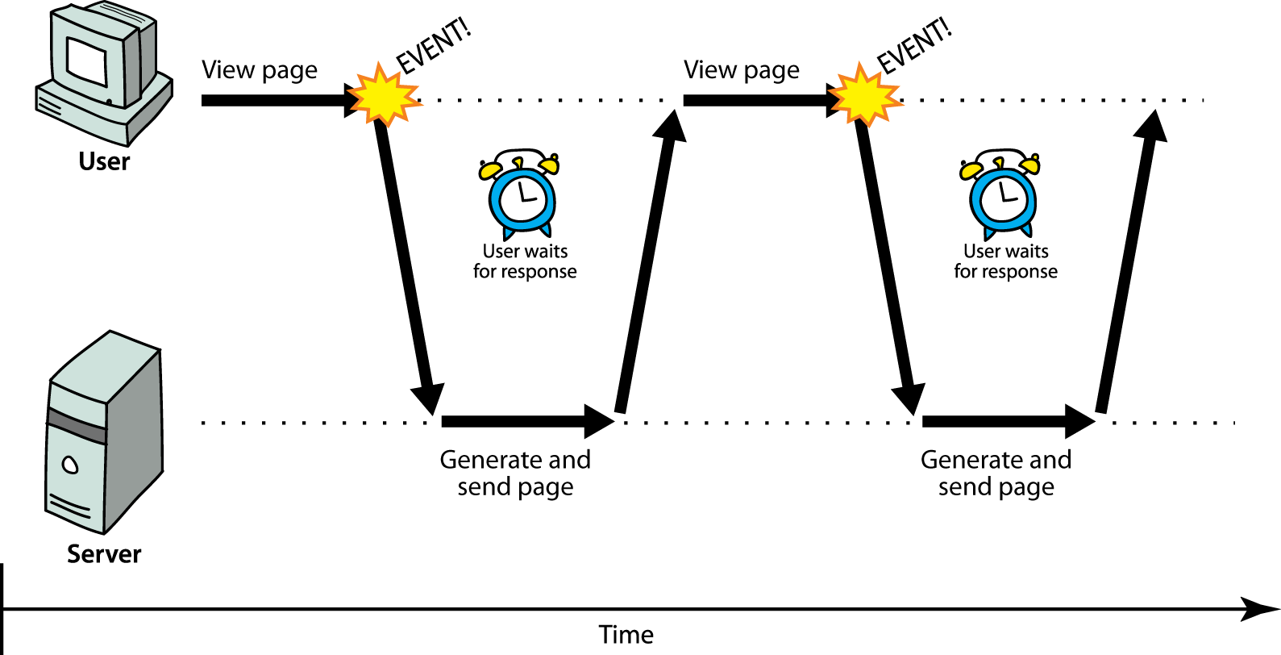
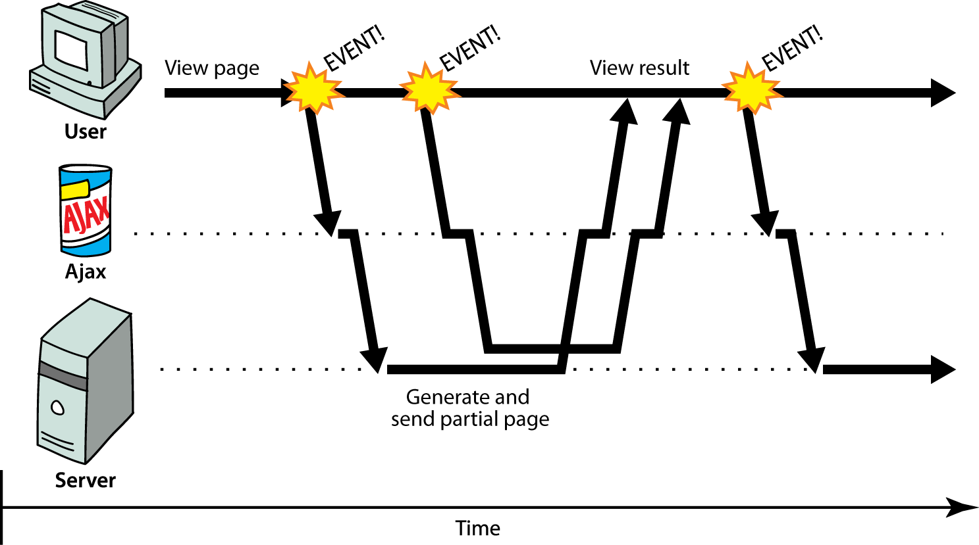
Request response loop
Synchronous
Asynchronous

Slide 5
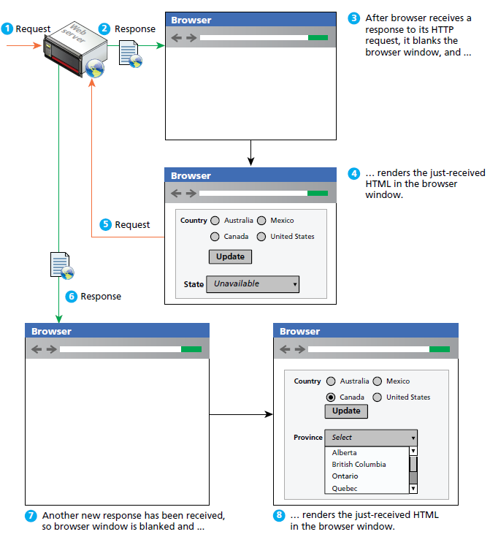
Normal synchronous HTTP request-response loop (non-AJAX)

Slide 6
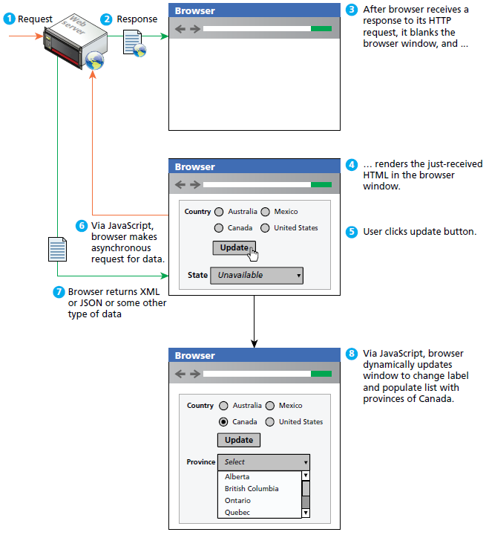
Asynchronous HTTP request-response loop (AJAX)
-Ajax allows client‐side JavaScript to request and receive data from a server without refreshing the web page
-This technique enables the developer to create an application that appears uninterrupted, making only portions of the page reload with new data

Slide 7
Javascript and AJAX
AJAX is a web browser technology independent of web server software
AJAX responsiveness is created via asynchronous data requests using JavaScript XMLHttpRequest object
AJAX provides web authors with a way to avoid the visual and temporal deficiencies of normal HTTP interactions
With AJAX web pages, it is possible to update sections of a page by making special requests of the server in the background, creating the illusion of continuity

Slide 8
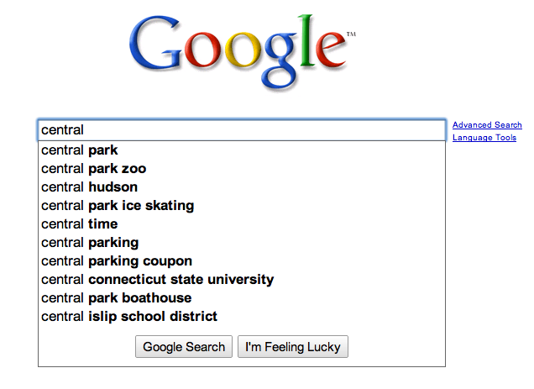
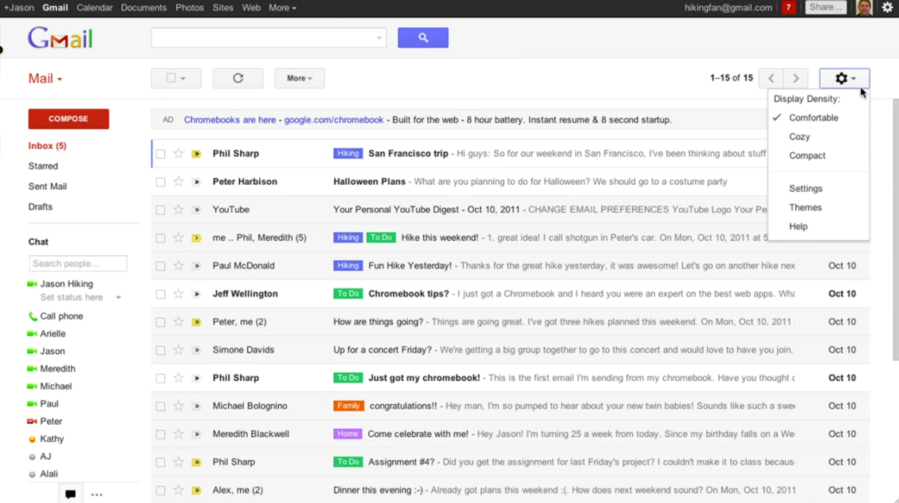
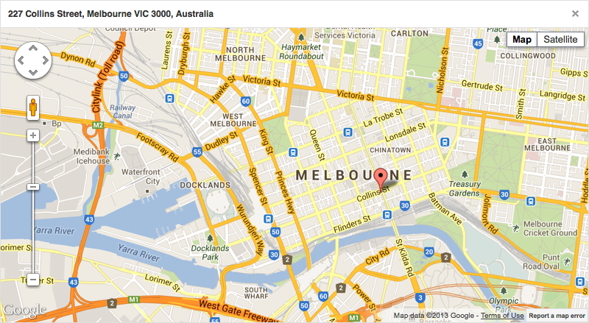
Notable AJAX Applications were first popularized by Google
Google Maps
Google Suggest
Gmail

Slide 9
AJAX API - XMLHttpRequest Object
The interface through which browser JavaScript can make HTTP requests is called XMLHttpRequest
It was designed by Microsoft, for its Internet Explorer browser, in the late 90s
During this time, the XML file format was very popular
When the XMLHttpRequest interface was added to Internet Explorer, it allowed people to do things with JavaScript that had been very hard before
For example, websites started showing lists of suggestions when the user was typing something into a text field
This was considered spectacular—people were used to waiting for a full page reload for every interaction with a website
The other significant browser at that time, Mozilla (later Firefox), did not want to be left behind. To allow people to do similarly neat things in its browser, Mozilla copied the interface
The next generation of browsers followed this example, and today XMLHttpRequest is a de facto standard interface

Slide 10
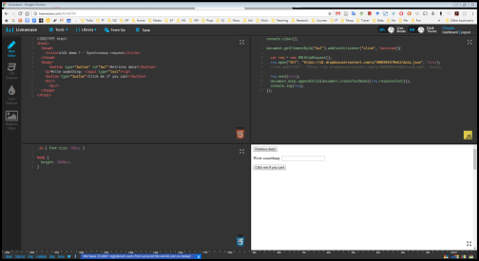
XMLHttpRequest synchronous request
The example creates an XMLHttpRequest object, which you can use to connect to, and request and receive data from the server.
AJAX requests have what's called a same domain policy, so you cannot request data objects from domains other than the one you're currently on (we will expand on this later)
To get around this problem we instantiate a simple Python Web server on the folder with our script ( just type python -m http.server in command prompt within the folder where your js script is located )
After instantiating the XMLHttpRequest object, we call the open() method.This method accepts three arguments.
requestType, is a string value consisting of the type of request to make (GET, POST, PUT, DELETE…)
The second argument is the URL to send the request to
The last parameter we pass to the open method is a Boolean that specifies whether we want the request to be asynchronous or not. To keep things simple, we're making that false, and that makes a request a synchronous request.
This makes our browser wait until the request is done before it does anything else, and this is generally a bad idea
Synchronous requests means that our program is suspended as long as the browser and server are communicating. When the connection is bad, the server is slow, or the file is big, that might take quite a while. Worse, because no event handlers can fire while our program is suspended, the whole document will become unresponsive.
After opening the request, we can send it with the send method. The argument to send is the request body. For GET requests, we can pass null.
var req = new XMLHttpRequest();
req.open("GET", "data.txt", false);
req.send(null);
console.log(req);
document.writeln(req.responseText);
Notes:
In the open method URLs that don’t start with a protocol name (such as http:) are relative, which means that they are interpreted relative to the current document. When they start with a slash (/), they replace the current path, which is the part after the server name. When they do not, the part of the current path up to and including its last slash character is put in front of the relative URL.

Slide 11
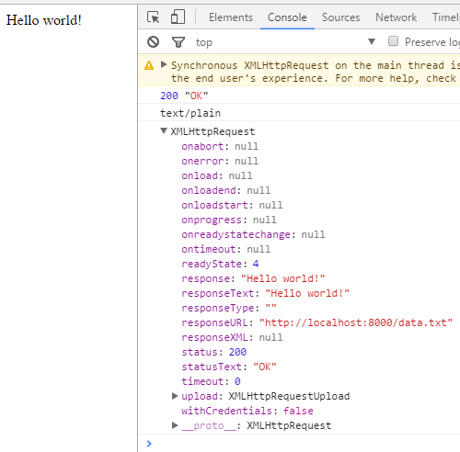
XMLHttpRequest synchronous request
The other information included in the response can also be extracted from the XMLHttpRequest object. The status code is accessible through the status property, and the human-readable status text is accessible through statusText.
Headers can be read with getResponseHeader.
var req = new XMLHttpRequest();
req.open("GET", "data.txt", false);
req.send(null);
console.log(req.status, req.statusText);
console.log(req.getResponseHeader("content-type"));
console.log(req);
document.writeln(req.responseText);
Notes:
In the open method URLs that don’t start with a protocol name (such as http:) are relative, which means that they are interpreted relative to the current document. When they start with a slash (/), they replace the current path, which is the part after the server name. When they do not, the part of the current path up to and including its last slash character is put in front of the relative URL.

Slide 12
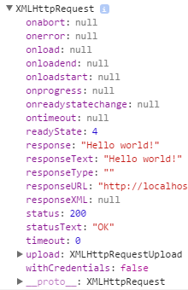
Asynchronous XMLHttpRequest
In the examples we saw, the request has finished when the call to send returns.
This is convenient because it means properties such as responseText are available immediately.
But it also means that our program is suspended as long as the browser and server are communicating.
When the connection is bad, the server is slow, or the file is big, that might take quite a while
This sort of synchronous code is said to be “blocking” and in many occasions is not desirable
If we pass true as the third argument to the XMLHttpRequest object open method, the request will be Asynchronous. This means that when we call send, the only thing that happens right away is that the request is scheduled to be sent. Our program can continue, and the browser will take care of the sending and receiving of data in the background.
We will need a mechanism that will notify us when the data is available.
For this, we can listen for the "load" event on the request object.
this forces us to use an asynchronous style of programming, wrapping the things that have to be done after the request in a function and arranging for that to be called at the appropriate time.
var req = new XMLHttpRequest();
req.open("GET", "data.txt", true);
req.addEventListener("load", function() {
console.log("Done:", req.status);
console.log(req);
document.writeln(req.responseText);
document.writeln(i);
});
req.send(null)

Slide 13
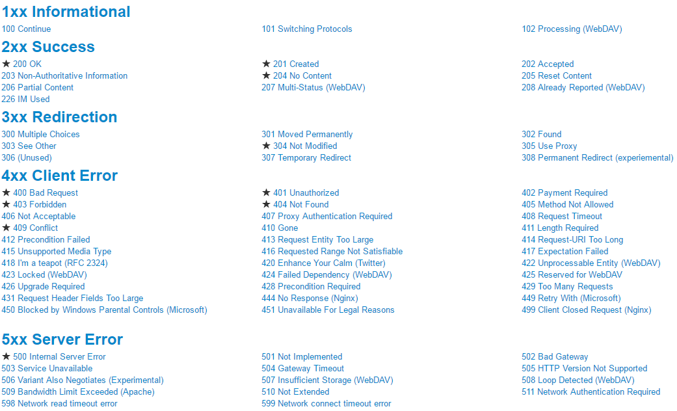
Status Property
Each XMLHttpRequest object has a status property.
This property contains the HTTP status code sent with the server’s response
The server returns a status of 200 for a successful request, and one of 404 if it cannot find the requested file

Slide 14
Asynchronous Requests
Asynchronous requests add some complexity to your code because you have to handle the readystatechange event.
In asynchronous requests, the XMLHttpRequest object exposes a readyState property, which holds a numeric value; each value refers to a specific state in a request’s life span
0: The object has been created, but the open() method hasn’t been called
1: The open() method has been called, but the request hasn’t been sent
2: The request has been sent; headers and status are received and available
3: A response has been received from the server
4: The requested data has been fully received
The readystatechange event fires every time the readyState property changes, calling the onreadystatechange event handler

Slide 15
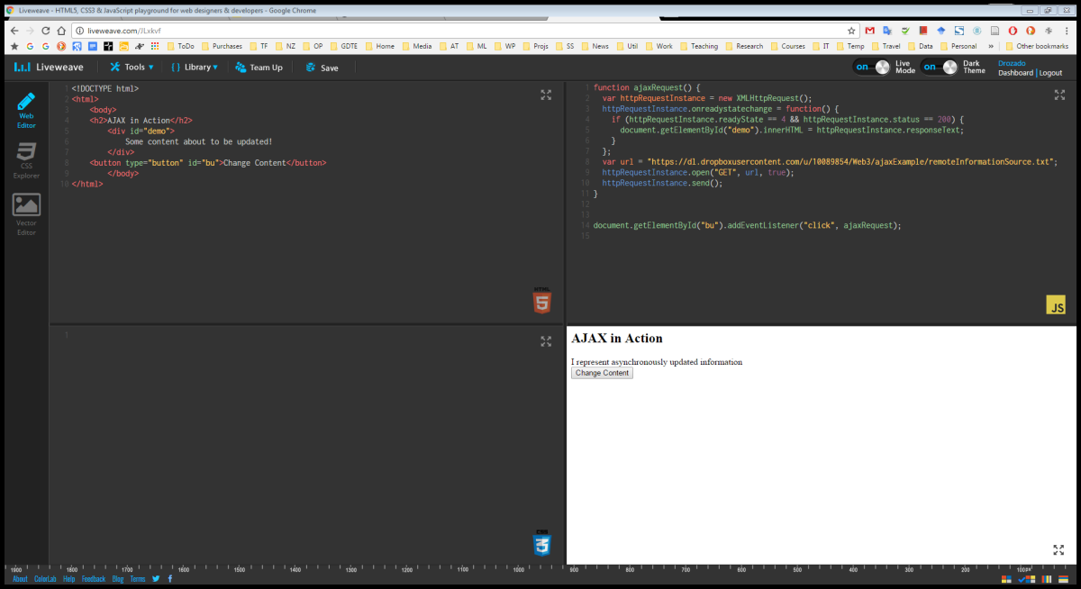
Asynchronous Ajax Demo with XMLHttpRequest
var request = new XMLHttpRequest();
request.open('GET', 'data.txt');
request.onreadystatechange = function() {
if ((request.readyState===4) && (request.status===200)) {
console.log(request);
document.writeln(request.responseText);
}
}
request.send();

Slide 16
HTTP access control (CORS)
A resource makes a cross-origin HTTP request when it requests a resource from a different domain than the one on which the first resource sits.
For example, an HTML page served from http://domain-a.com makes an <img> src request for http://domain-b.com/image.jpg. Many pages on the web today load resources like CSS stylesheets, images and scripts from separate domains.
JavaScript cannot access scripts or documents from a different origin to its own
This is used to security reasons, most browsers restrict cross-origin HTTP requests initiated from within scripts. For example, the XMLHttpRequest object follows the same-origin policy.
A web application using XMLHttpRequest could only make additional HTTP requests to its own domain (i.e. origin)
To improve web applications, developers asked browser vendors to allow cross-domain requests.
The Cross-Origin Resource Sharing (CORS) mechanism gives web servers cross-domain access controls, which enable secure cross-domain data transfers. Modern browsers use CORS in an API container - such as XMLHttpRequest - to mitigate risks of cross-origin HTTP requests.
The same‐origin policy dictates that two pages are of the same origin only if the protocol (HTTP), port (the default is 80), and host are the same
Consider the following two pages:
http://www.site.com/folder/mypage1.htm.
http://www.site.com/folder10/mypage2.htm.
According to the same‐origin policy, these two pages are of the same origin. They share the same host (www.site.com), use the same protocol (HTTP), and are accessed on the same port (none is specified; therefore, they both use 80).

Slide 17
The Same‐Origin Policy
Now consider the next two pages:
http://www.site.com/folder/mypage1.htm.
https://www.site.com/folder/mypage2.htm.
These two pages are not of the same origin.
The host is the same, but their protocols and ports are different.
Page 1 uses HTTP (port 80)
Page 2 uses HTTPS (port 443).
This difference, though slight, is enough to give the two pages two separate origins.
Therefore, JavaScript on one of these pages cannot access the other page

Slide 18
The Same‐Origin Policy
Because of this policy, an XMLHttpRequest object cannot retrieve any file or document from a different origin by default.
The CORS specification defines how browsers and servers communicate with one another when sending requests across origins.
The Cross-Origin Resource Sharing standard works by adding new HTTP headers that allow servers to describe the set of origins that are permitted to read that information using a web browser.
For CORS to work, the browser must send a custom HTTP header called Origin that contains the protocol, domain name, and port of the page making the request.
When the server responds to a CORS request, it must also send a custom header called Access‐Control‐Allow‐Origin, and it must contain the same origin specified in the request’s Origin header.
If this header is missing, or if the origins don’t match, the browser doesn’t process the request
Alternatively, the server can include the Access‐Control‐Allow‐Origin header with a value of *, signifying that all origins are accepted

Slide 19
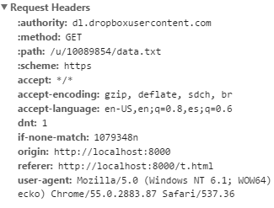
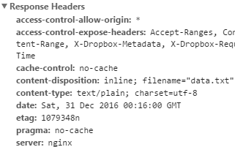
CORS example
var request = new XMLHttpRequest();
request.open('GET', 'https://dl.dropboxusercontent.com/u/10089854/data.txt');
request.onreadystatechange = function() {
if ((request.readyState===4) && (request.status===200)) {
console.log(request);
document.writeln(request.responseText);
}
}
request.send();

Slide 20
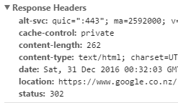
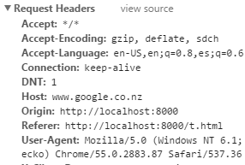
CORS example
var request = new XMLHttpRequest();
request.open('GET', 'http://www.google.com');
request.onreadystatechange = function() {
if ((request.readyState===4) && (request.status===200)) {
console.log(request);
document.writeln(request.responseText);
}
}
request.send();

Slide 21
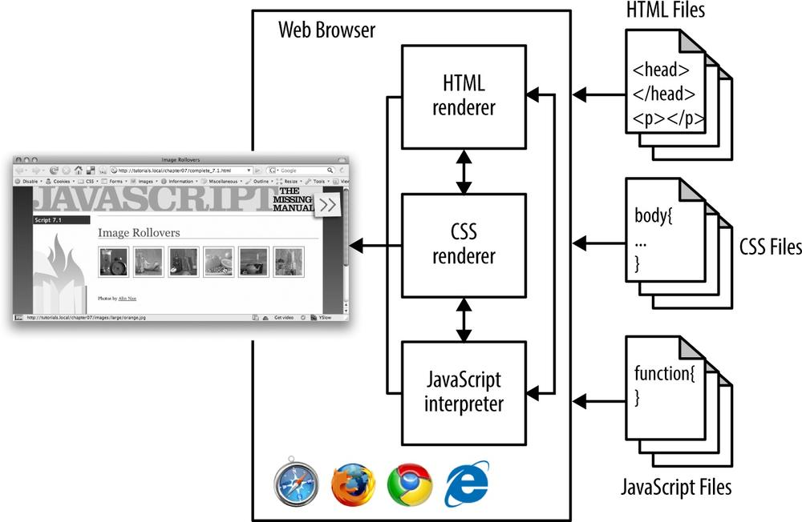
What is a browser made of?

Slide 22
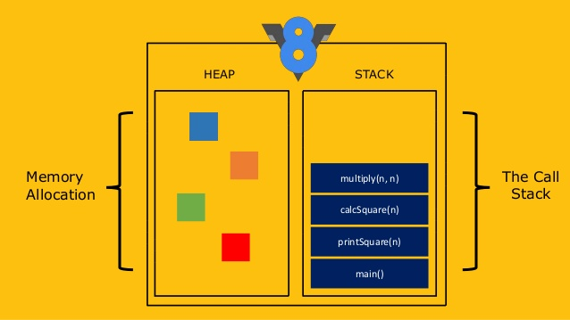
What is a JavaScript engine?

Slide 23
How does the Javascript call stack work?
Call stack
function multiply(a,b){
return a*b;
}
function square (n){
return multiply (n,n);
}
function printSquare(n){
var squared = square(n);
console.log(squared);
}
printSquare(4);
a*b
multiply(n,n)
square(n)
console.log(squared)
printSquare(4)
Notes:
Great visualisation to help you understand how JavaScript's call stack/event loop/callback queue interact with each other:
http://latentflip.com/loupe

Slide 24
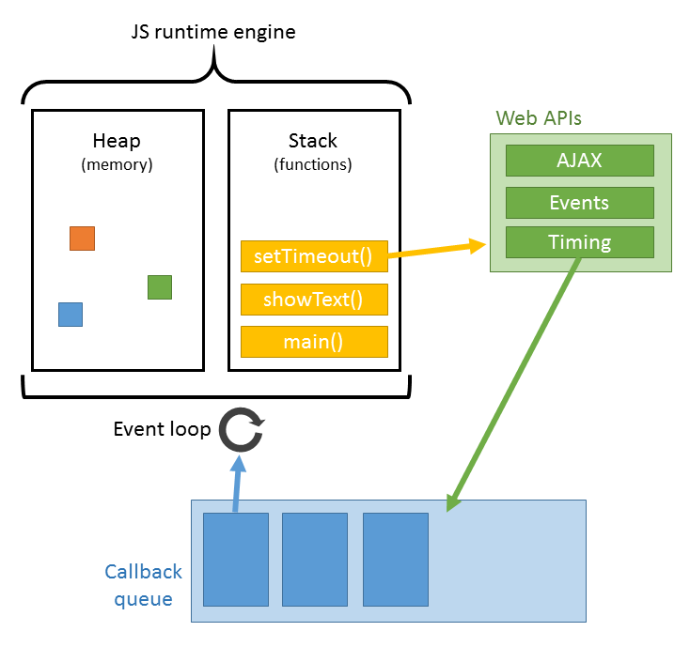
JavaScript event loop
JavaScript is single-threaded, non-blocking, asynchronous concurrent language with a call stack, event loop, a callback queue and some APIs. But Google’s V8 runtime engine only has a call stack and a heap.
The Web APIs, event loop and the callback queue are provided as external tools by the browser, and are not inherent to the V8 runtime.
Javascript event loop demo:
http://latentflip.com/loupe/

